Slide 1

Projects / Skills list
Let’s Dive In
GO through all slides

Slide 2
Blood bank management system (DBMS crud operations )
Binary Clock (computer graphics )
ColabDEV (code collaboration tool )
Login automation (selenium web automation)
I-Sikho
TTSSTT
NoCode web development with Grape.js
Data science project with Weka on Wingo data

Slide 3
Helped others with
\Park management system
\Flower shop management system
Worked on OPENSTACK (building cloud infrastructure with opensource software)

Slide 4
BBMS
Let’s Dive In

Slide 5
BBMS
As part of my fifth semester curriculum this was my mini project for DBMS laboratory.
Team size 4.
Wrote PHP program to perform Create, Read, Update and Delete operations on relational database MySQL
Handled html pages too partly

Slide 6
Binary clock
Let’s Dive In

Slide 7

Binary Clock
In this project we used OpenGL open graphics library C++ variant.
Link to documentation here

Slide 8
ColabDEv
Let’s Dive In

Slide 9
ColabDev
A code collaboration tool.
Technology used are React, Express and Node.js
Team size 3
This project was modified to I-Sikho later.

Slide 10
Login automation
Let’s Dive In

Slide 11
Login Automation
Problem was we need to login every time for web to college portal .
What I did was generated python selenium script from Katalon web testing suite and modified it to run with selenium's chrome webdriver and wrote a windows batch script to start the script at login.

Slide 12

I-sIKHO (INTERACTIVE SIKHO)
React js and websocket
Author :
SHIVANAGOUDA R PATIL
17.10.2023

Slide 13
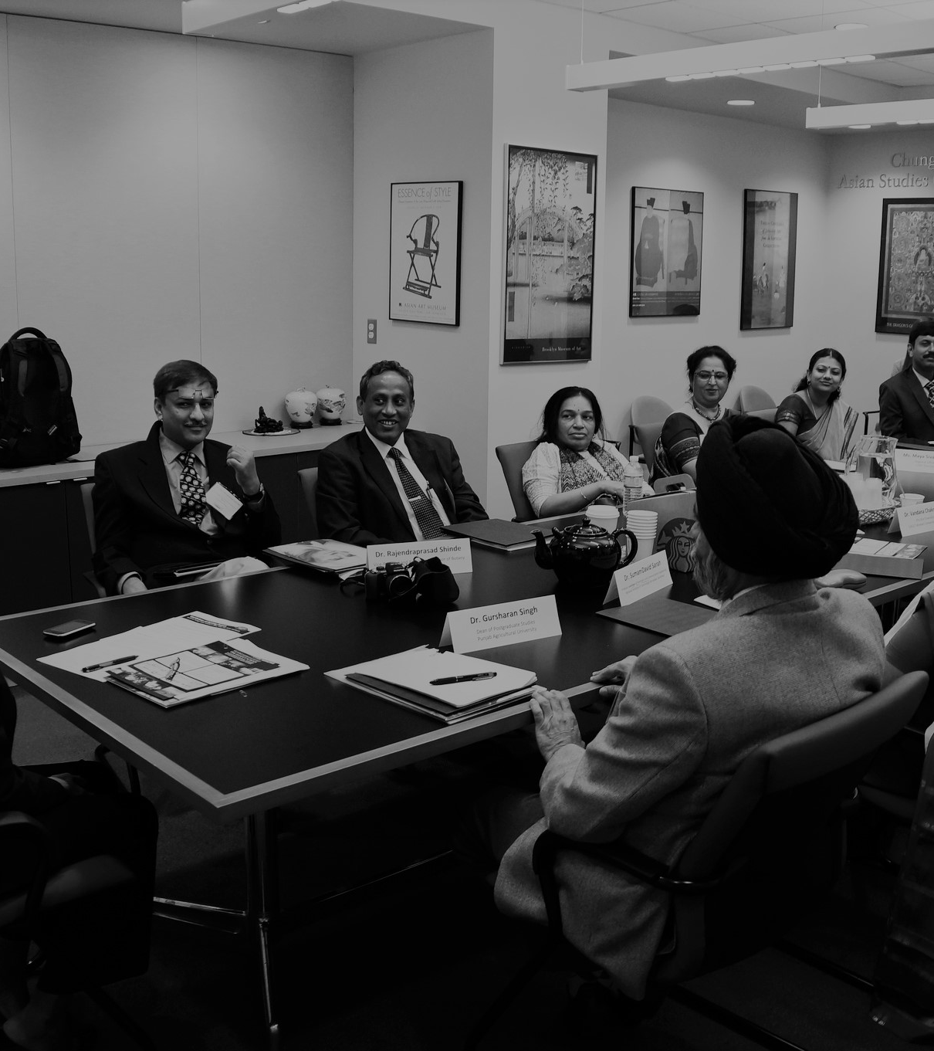
Agenda
Introduction/background
Literature Survey
Objectives
Methodology
Results
Contributions
Project deliverables

Slide 14
Agenda {CONTINUED }
Challenges
Conclusions
Scope for future work

Slide 15

INTRODUCTION
MOTIVATION
On a positive note, NEW EDUCATION POLICY 2020 considers programming as skillset of future, which favors us in this project in future.
Learning programming changes perspective towards life.
“Whether you want to uncover the secrets of the universe, or you just want to pursue a career in the 21st century, basic computer programming is an essential skill to learn.” - Stephen Hawking
PROBLEMS OUR PROJECT SOLVING
Pandemic and pandemic which affected everyone .
Teaching programming without actual live coding can be crumbles US.

Slide 16
Literature survey
Let’s Dive In

Slide 17
Existing code collaboration tools like GitHub, Bitbucket doesn't favor interaction (you need to know commands git push ,pull ,clone, rebase etc. )
In case of online courses, there is lack of human interaction itself, which affects basic principle of humans as a social animal.
“A single conversation across the table with a wise man is better than ten years’ mere study of books.” –Henry Wadsworth Longfellow

Slide 18
objectives
Yeah, this is WHAT we are solving

Slide 19
Intuitive frontend design. {stage 0}
To create Online coding platform (Progressive Web App). {stage 0}
Multi programming language support. {stage 0}
Aiding with a whiteboard concept as in class. {stage 0}
Enabling Videoconferencing. {stage 0}
Code saving capability. {stage 0}
Making very own APIs for this .{stage *}
Featuring Multilanguage support. {stage 1}
Code Version controlling. {stage 2}
Deployment on cloud applying microservice architecture. {stage *)

Slide 20
methodology
This is how we are doing it
One step at a time

Slide 21
Stage 0*
Current stage of project
Stage 1*
Stage 2*
Whiteboard module
Intuitive frontend design
module
Videoconferencing
module
* means
To develop own APIs
Deployment using cloud microservice architecture
Coding platform module
Multiprogramming languages module
Code saving module

Slide 22
The development of the project is divided into multiple modules.
The main module, Coding Platform, is the core of the project. This module consists of developing a compiler for working on programs.
The other module, Design, is the main interface of the project, using which users can make use of the features of the project.

Slide 23
contributions
credits

Slide 24
Nodejs APIs
React ,Express ,JavaScript APIs
Material UI API
Judge API
Postman for API testing

Slide 25
Project deliverables
I-sikho itself

Slide 26
Progressive Web App (PWA) for Computerphiles

Slide 27
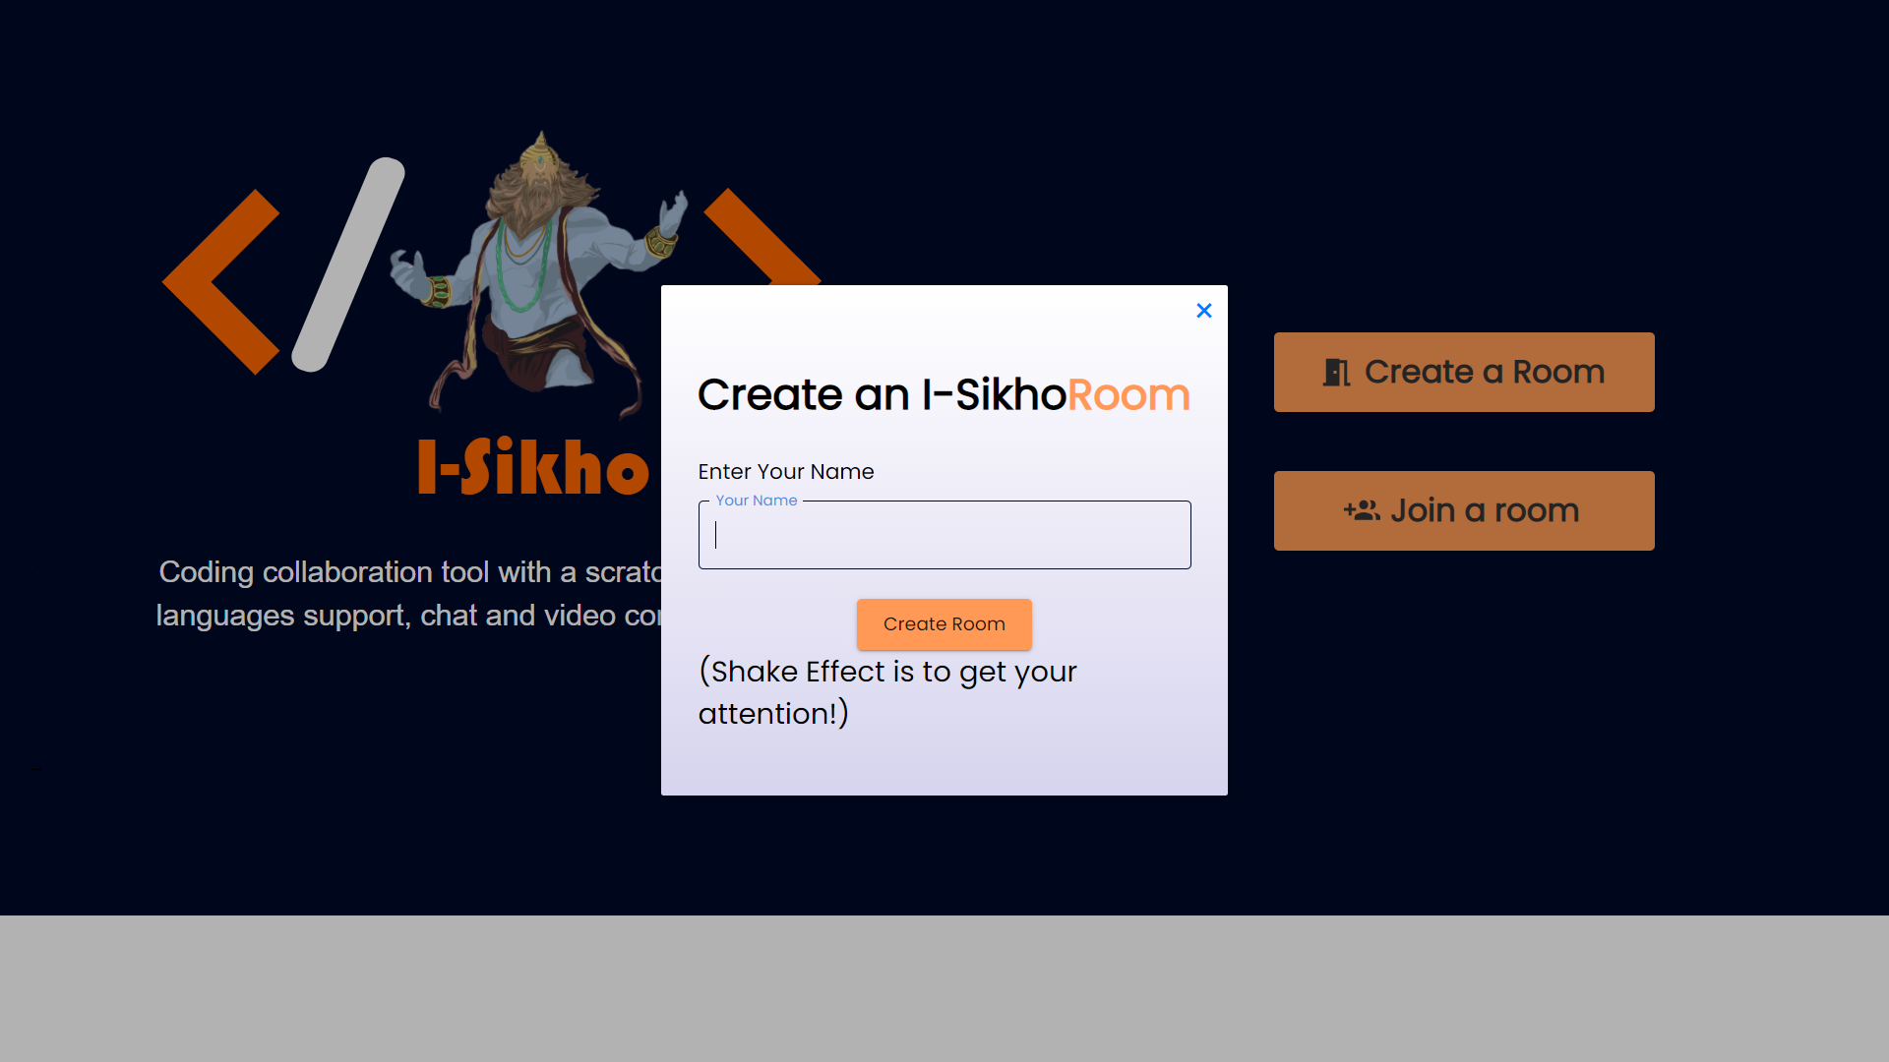
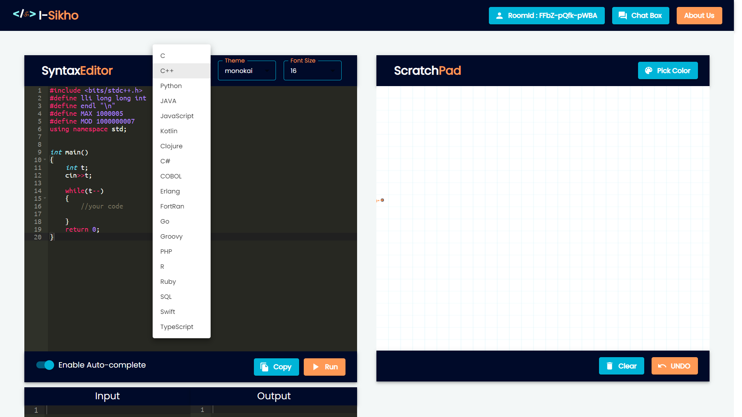
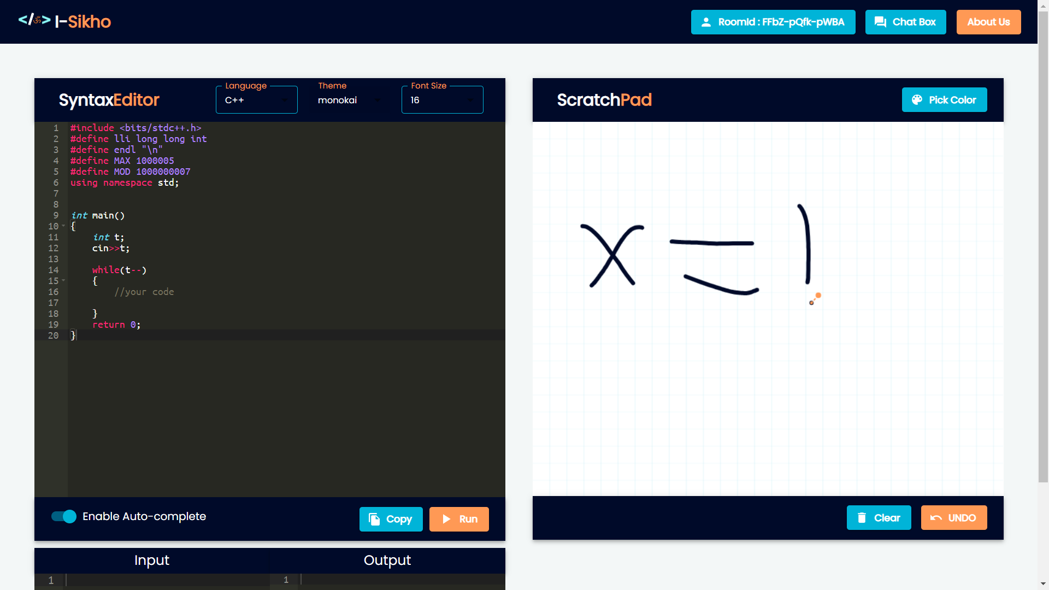
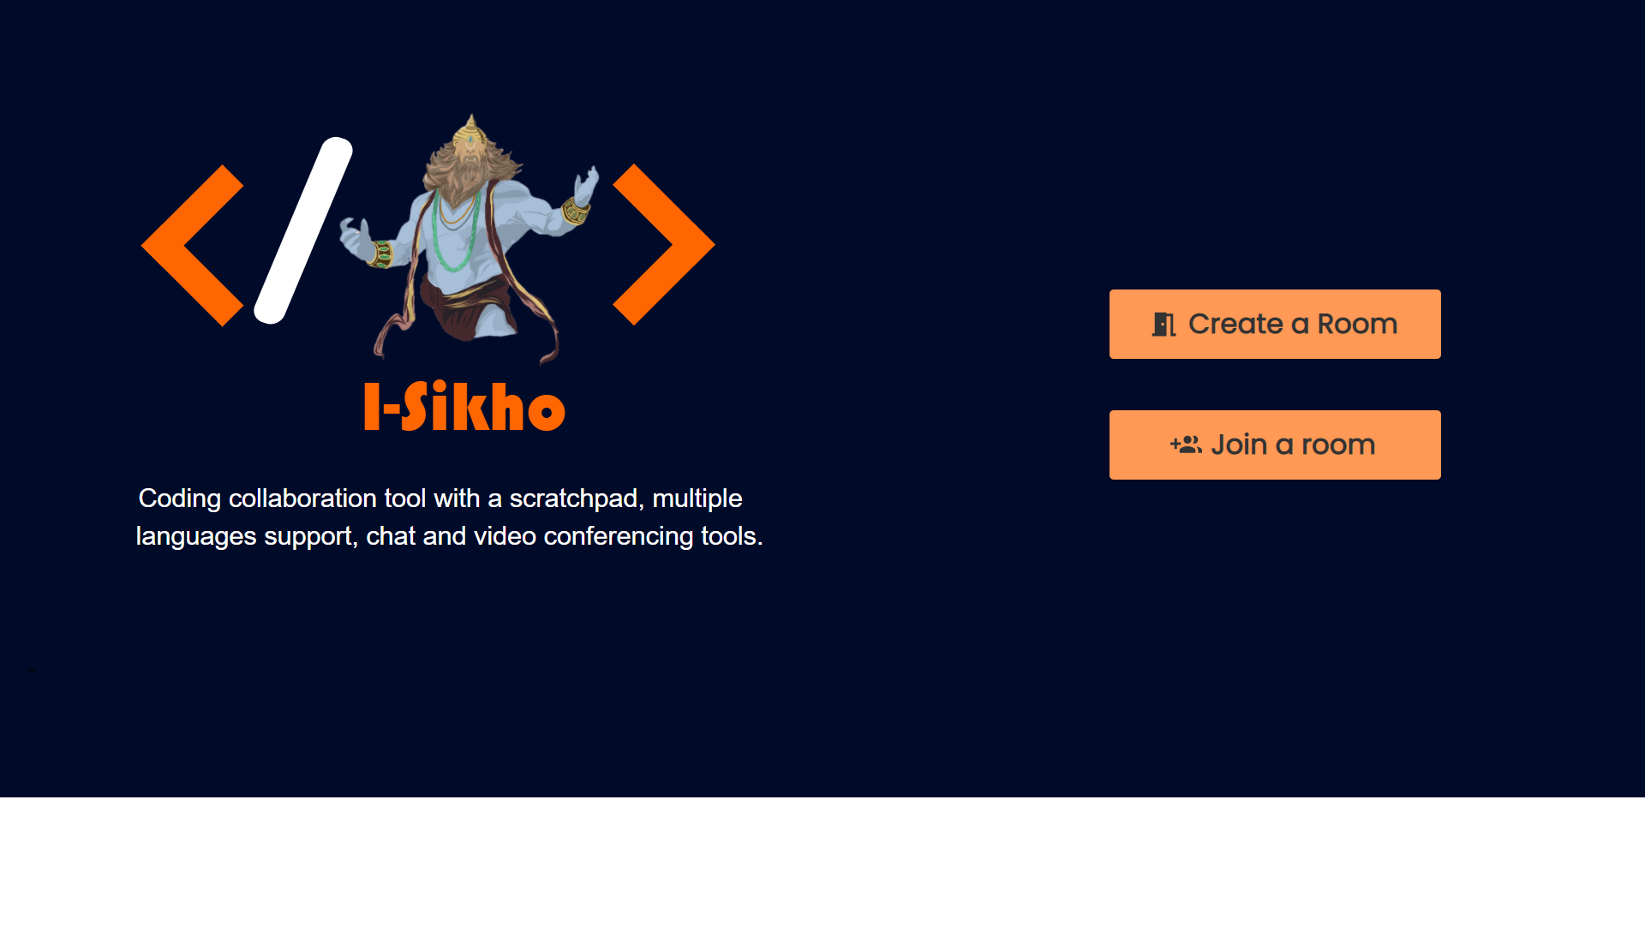

Slide 31
challenges
It's tough ,nothing comes easily

Slide 32
Since it is third party APIs based, any change would require modifications. Challenge is to develop API independent PWA.
Implementation at stage 2 code version controlling sounds troublesome.

Slide 33
conclusion
Let's do this

Slide 34
Let's welcome NEP2020, and
Education revolution flourish. Our solution aids the learning process of programming remotely, intuitively and seamlessly.

Slide 35
Scope for future work
Alternate use cases

Slide 36
Incorporating the new languages that may be foreseen.
Customizing for software development teams, remotely possibly.
Developing it as a conference application.
Incorporating White board application for demonstration purposes.

Slide 37



THANK YOU
Team I-Sikho
+91 7975113388
1000sp0001@gmail.com
Peace OUT..!

Slide 38
bibliography
6 Great Quotes About the Power of Coding (hatchcoding.com)
https://reactjs.org/
https://material-ui.com/
Expressjs.com
Rapidapi.com

Slide 39
Ttsstt
Let’s Dive In

Slide 40
TTSSTT
Text To Speech Speech To Text
It does does dictate what we wrote further write what we dictate.
MVP link.

Slide 41
No code / low code platform
Let’s Dive In

Slide 42
No code /low code platform
This currently at MVP stage.
This is productivity tool to generate from code from
Web design ,which helps in rapid prototyping and
Development.

Slide 43
DAta science project
Let’s Dive In

Slide 44


Data Science Project with weka
Wingo is a online colour
prediction game with data from kaggle.
I ran data against weka and analysed
Its decision tree.
This Photo by Unknown author is licensed under CC BY-SA-NC.

Slide 45
Skills set
Let’s Dive In

Slide 46


















.

Slide 47
THANK YOU
Team I-Sikho
+91 7975113388
1000sp0001@gmail.com
Shivapatil@pm.me
Peace OUT..!

